Slide 1

BLOOD BANK MANAGEMENT SYSTEM
Presented by:
Marreddi Jayanth Sai (2021BCS-040)
Aryan Sharma (2021BCS-072)
Sachin Jayadev (2021BCS-074)
Submitted to:
Dr. Santosh Singh Rathore

Slide 2

ABSTRACT
We will be putting into practice the concepts we learnt in object oriented programing systems course as in, "Blood Bank Management System." We will implement distinct relations as classes and each entry as an instance or object.
We'll employ the basic OOPS ideas of inheritance, polymorphism, encapsulation, composition, etc. We have included various header files to reduce the cognitive load to the one viewing the code.

Slide 3


TABLE OF CONTENTS
01
02
INTRODUCTION
CLASS DIAGRAM
03
04
IMPLEMENTATION
LEARNINGS
Gives a rough Idea about the project
Contains the class diagram and a brief display of various sectors in the code
Gives a brief description on our learnings through the course of this project
Contains screenshots of different parts of the outputs generated

Slide 4

01
INTRODUCTION

Slide 5
INTRODUCTION
Due to increased awareness of the need to donate blood for those in need, the percentage of individuals donating blood is rising daily. Over time, it had grown more difficult to keep track of all the donors and recipients. Our Blood Bank Management system attempts to address this issue

Slide 6

MISSION
One faulty blood donation causes many incurable diseases, thus we aim to address this problem by creating an effective management system employing OOPS we have learned.
VISION
After the completion of this project, we want to continue working on it and eventually develop it to its full potential.

Slide 7






CLASS DIAGRAM
02

Slide 8
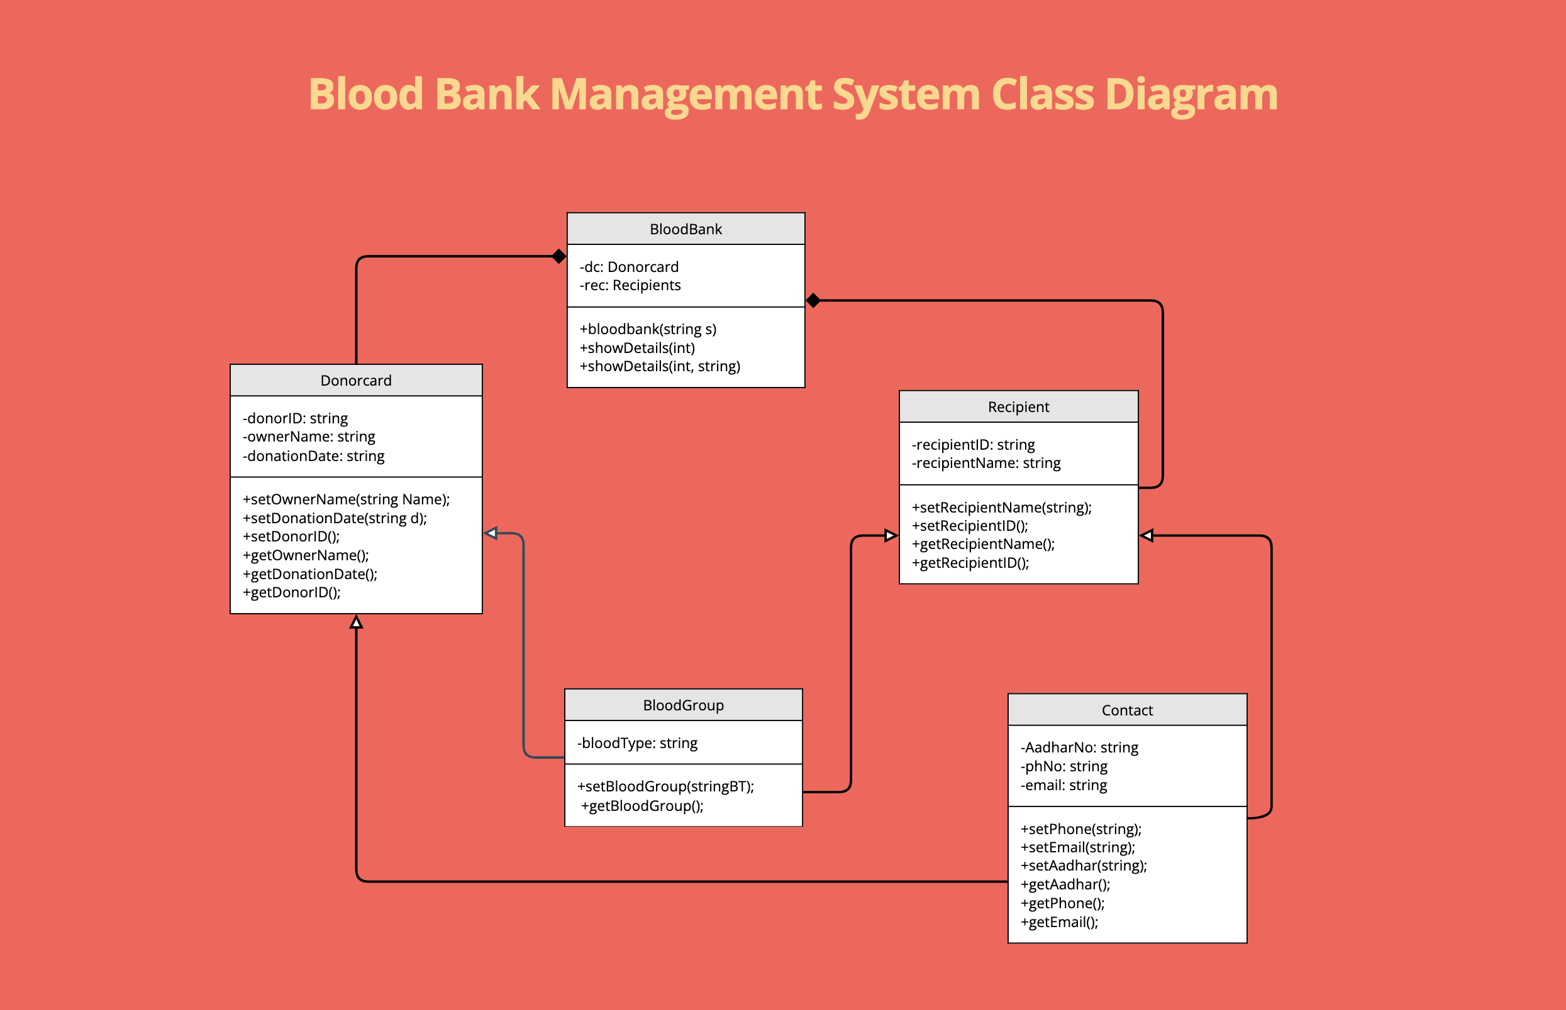

Slide 9
OUR CLASSES
DONOR CARD
Contains all the details of the Donor
BLOOD BANK
The main Entity
BLOOD GROUP
Contains the blood group that being donated to the Blood Bank

Slide 10
OUR CLASSES
RECIPIENT
CONTACT
Contains the information related to the recipient
Contains the contact details of both recipient as well as the donor

Slide 11
BLOOD GROUPS
The Class Blood group consists of the object blood group and a getter and setter function for it and an id
This class contains the information of which blood is donated by the Donor which makes it a one to one relationship with donor card as a person will be having a unique blood groups

Slide 12
OUR LEARNINGS
The Project increased the communications between the members of the group (collaborative efforts) and broadened our mind. This also helped us strengthen the fundamentals of the OOPS and how to use its ideas to create fully functional program has improved throughout the course of this project.
It was a laborious process to create separate Header and Source files for each classes since included so many files in the main file resulted in several problems. However, after finishing it, we had a better understanding of how everything functions as well as how to work on a group project's code, including debugging and connecting everyone's code, etc.

Slide 13

An Object Oriented Programming Project by
MARREDDI JAYANTH SAI 2021-BCS-040
ARYAN SHARMA 2021-BCS-072
SACHIN JAYADEV 2021-BCS-074
Under The Guidance Of
DR.SANTOSH SINGH RATHORE
Through
Atal Bihari Vajpayee Indian Institute of Information Technology and Management (ABV-IIITM), Gwalior

